Slide 1

Stock Price Prediction using Machine Learning
Yes Bank – EDA to Model Comparison

Slide 2
Project Overview
Objective: Predict Yes Bank's monthly closing prices
Data: 2005–2020 OHLC prices
Tools: Python, Pandas, Matplotlib, Seaborn, scikit-learn
Approach: EDA → Feature Selection → Model Building

Slide 3
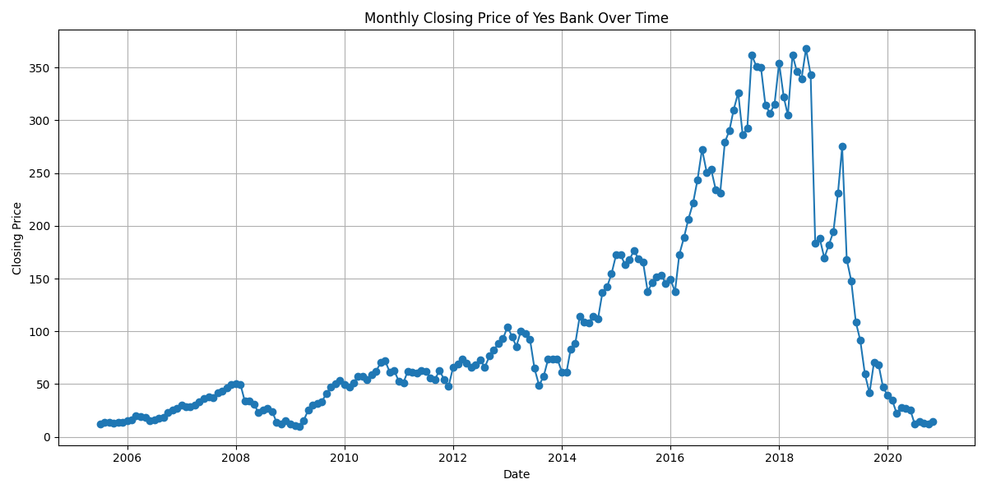
Monthly Closing Price Over Time
The stock showed consistent growth till 2018
Post-2018: Sharp decline due to market or internal issues

Slide 4
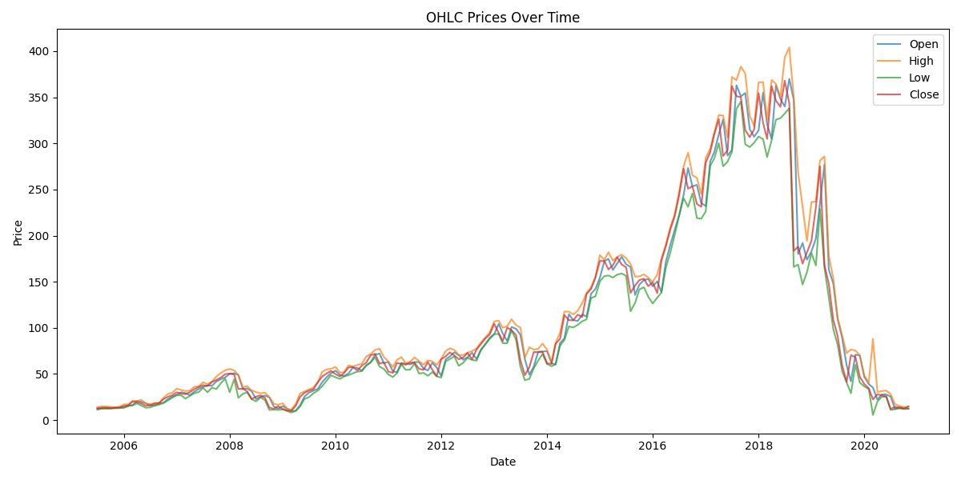
OHLC Prices Over Time
Open, High, Low, and Close prices move together
Strong feature correlation supports predictive modeling

Slide 5
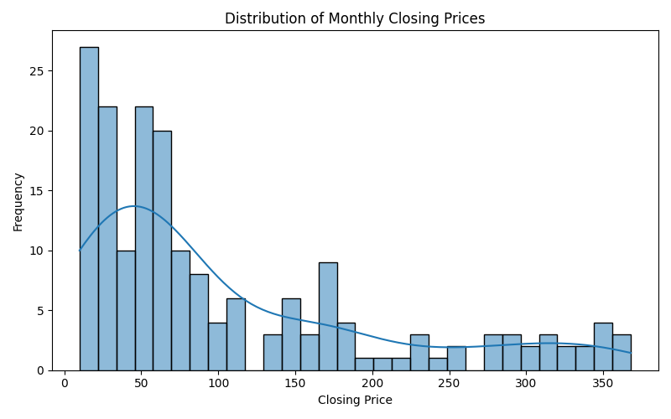
Distribution of Monthly Closing Prices
Right-skewed distribution with outliers
Most prices cluster below ₹100; few extreme values detected

Slide 6
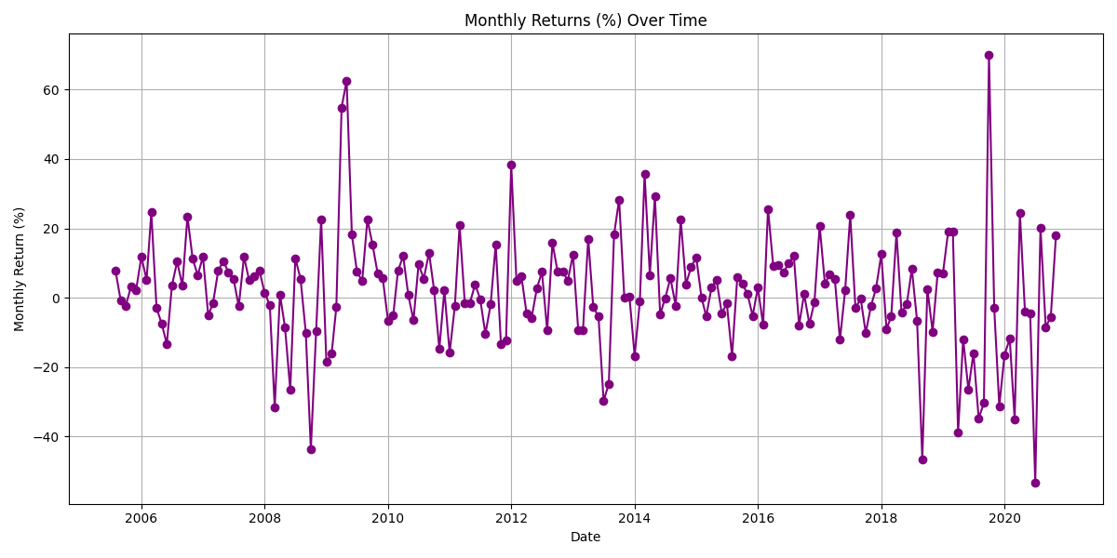
Monthly Returns Over Time
High volatility detected in returns (±60%)
Indicates unstable investment environment

Slide 7
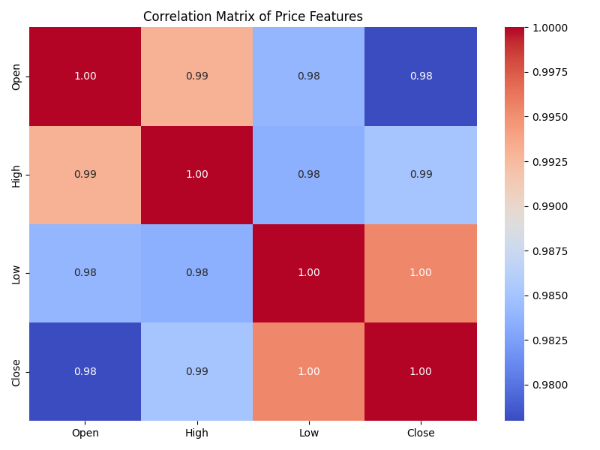
Correlation Heatmap
OHLC features show very high correlation (≥ 0.98)
Multicollinearity must be addressed with regularization

Slide 8
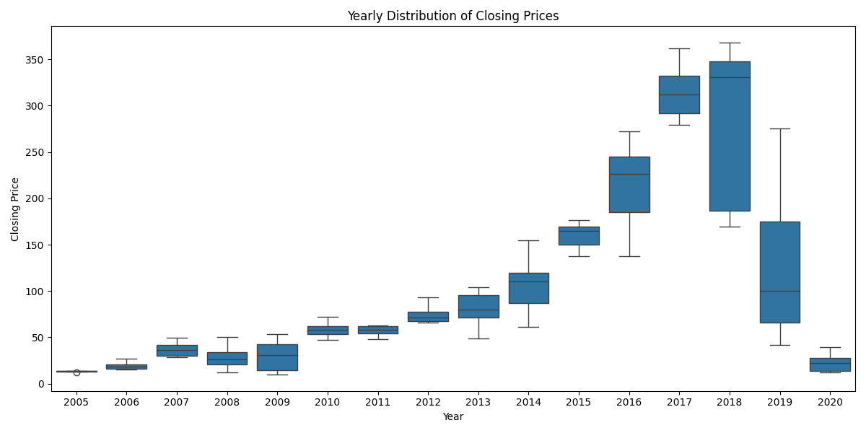
Yearly Boxplot of Closing Prices
Price volatility increased between 2015–2018
Collapse post-2019 signals investor confidence loss

Slide 9
Summary of EDA Observations
Peak in 2018 followed by a crash
Multicollinearity and skewness observed
Extreme volatility in returns
Model choice influenced by EDA

Slide 10
ML Models Used
Linear Regression – baseline model
Ridge Regression – regularized linear model
Random Forest Regressor – non-linear ensemble

Slide 11
Correlation Matrix – Revisited
Supports need for Ridge Regression or Random Forest
Plain linear models may overfit due to feature redundancy

Slide 12
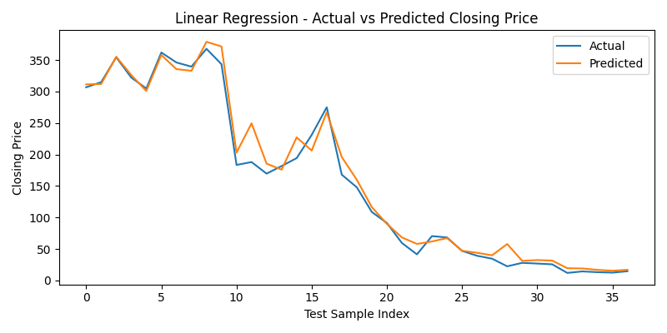
Linear Regression – Actual vs Predicted
Captures overall trend
Underperforms during volatile price drops

Slide 13
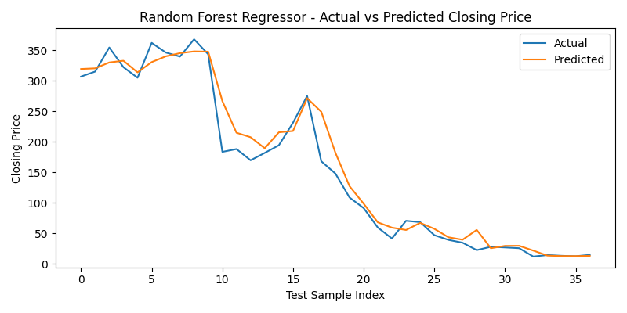
Random Forest – Actual vs Predicted
Handles non-linearity well
Best performance across both stable and unstable periods

Slide 14
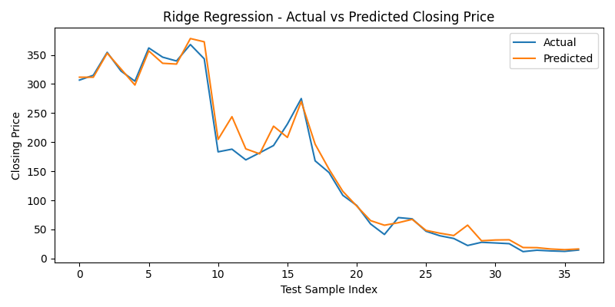
Ridge Regression – Actual vs Predicted
Improves on Linear Regression through regularization
Better generalization on unseen data

Slide 15
Final Takeaways
Random Forest provided the most accurate predictions
EDA was critical in guiding feature and model choices
Regularization (Ridge) improved model stability

Slide 16
Future Work
Try time series models (ARIMA, LSTM)
Deploy model using Flask or Streamlit
Incorporate real-time data sources

Slide 17

Thank You

